Slide 1
Proper coding techniques

Slide 2
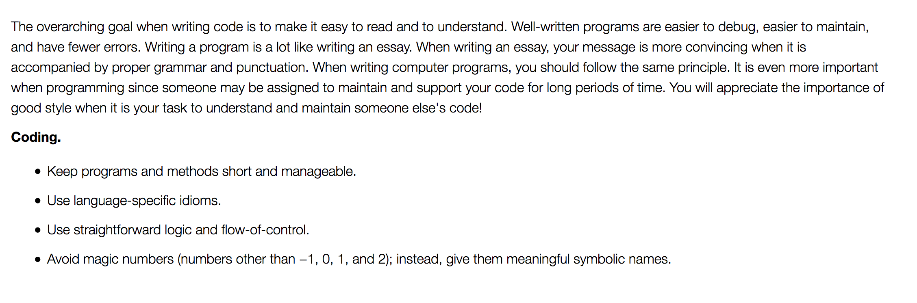

Slide 3
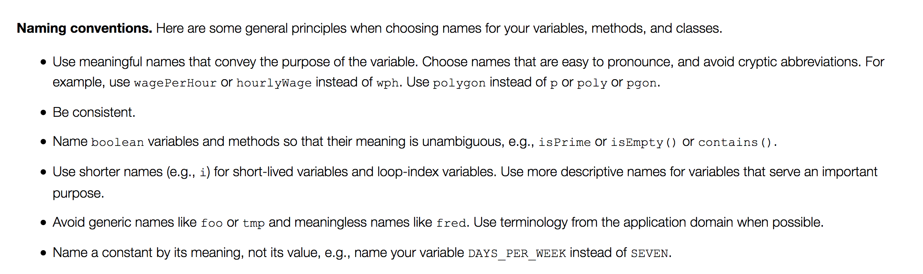

Slide 4
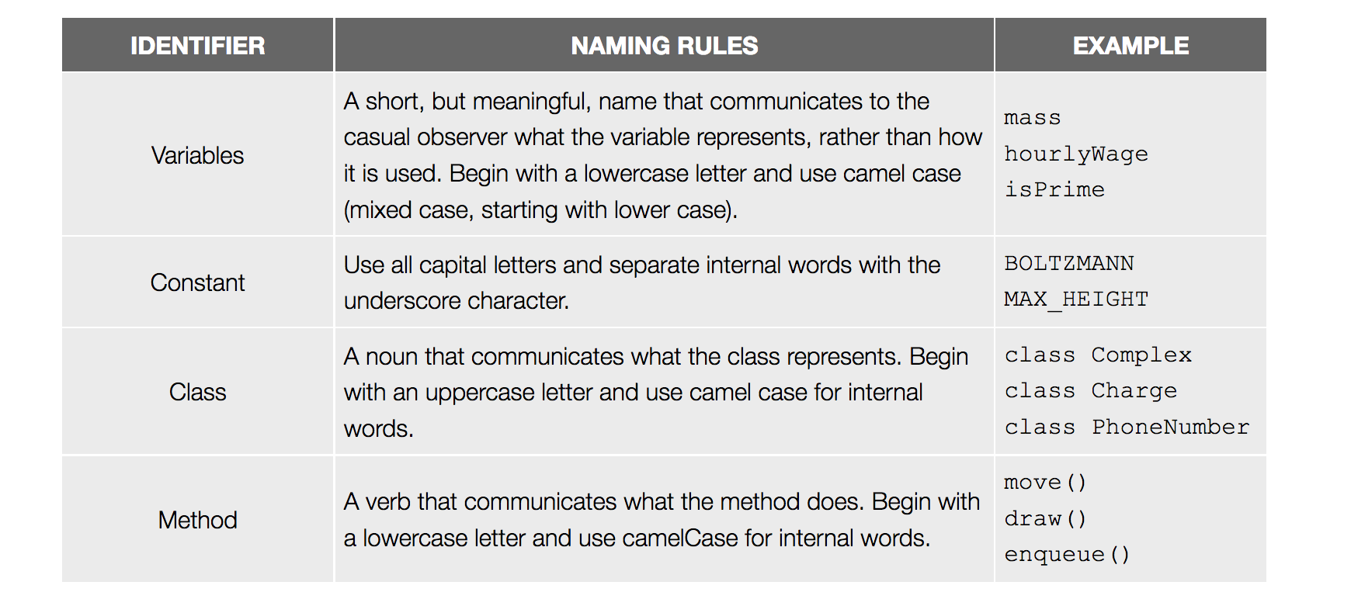

Slide 5
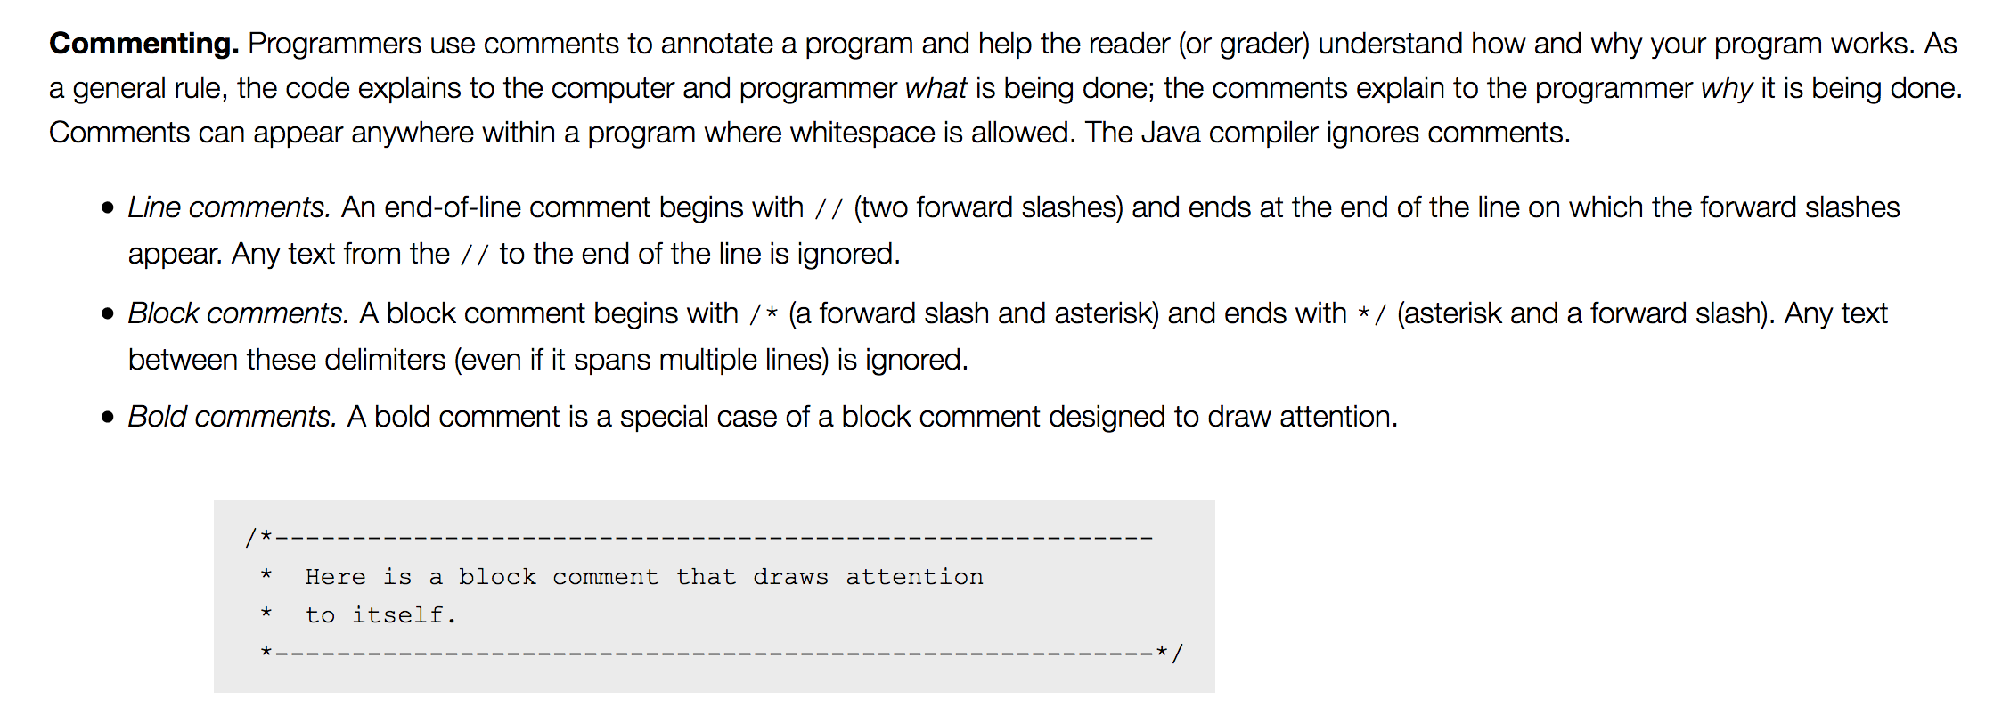

Slide 6
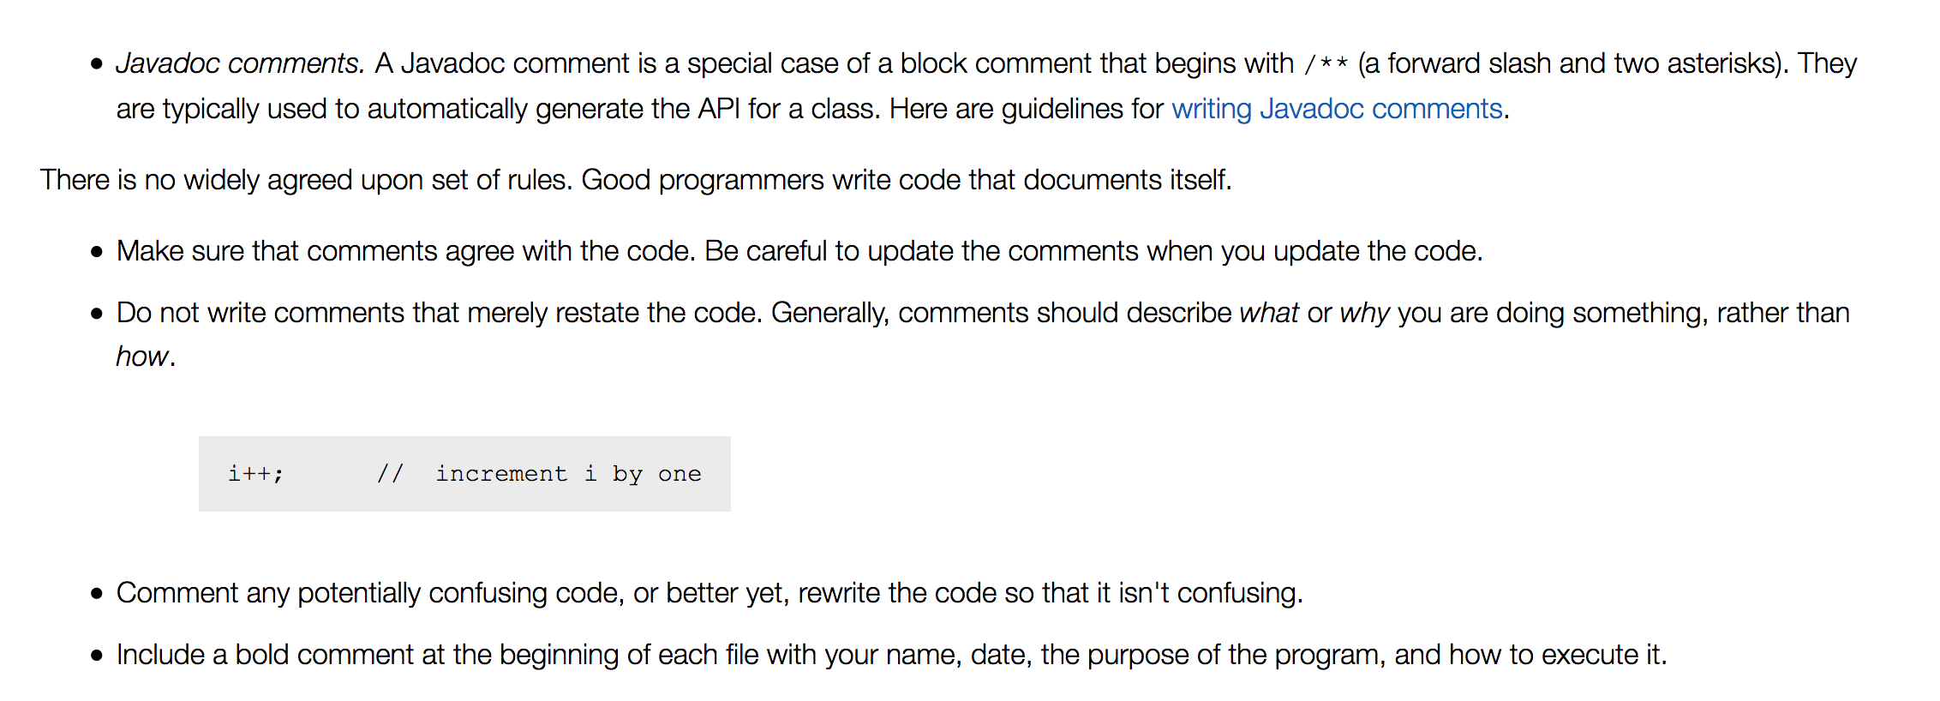

Slide 7
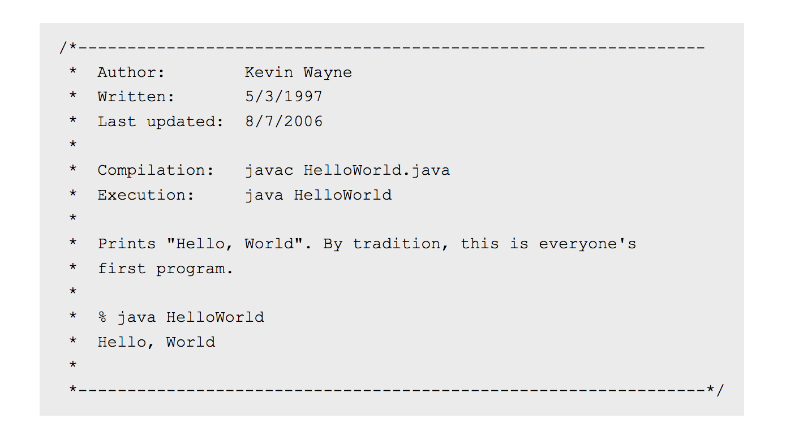

Slide 8
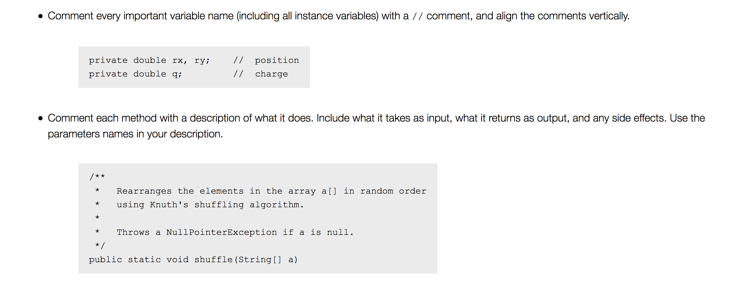

Slide 9
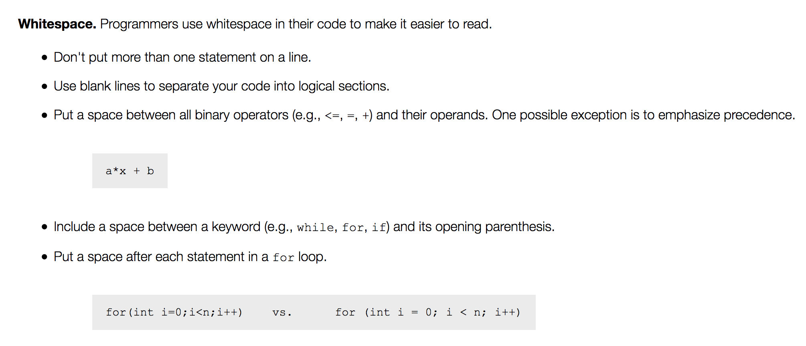

Slide 10
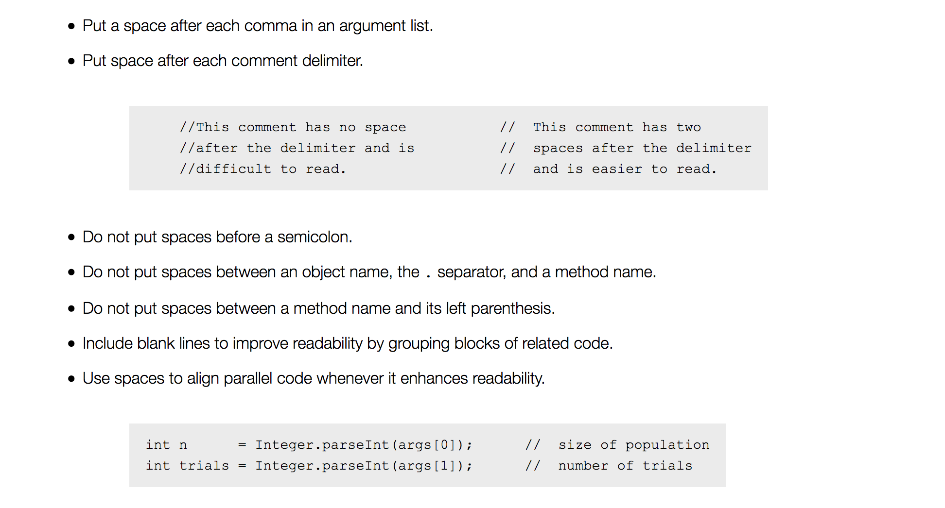

Slide 11
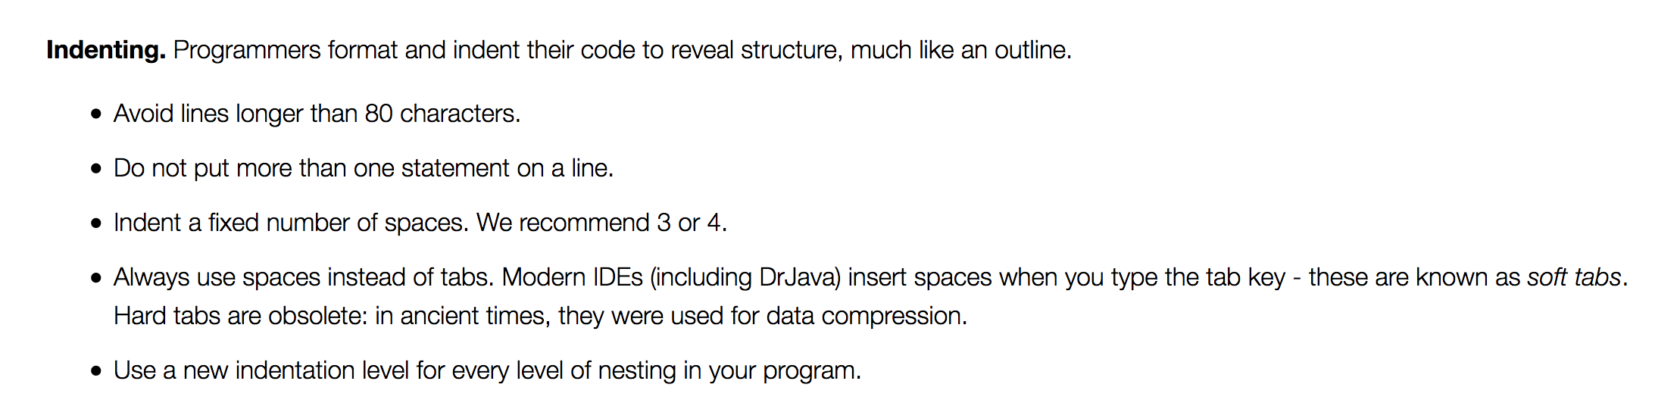
Adapted from Princeton University and Introduction to Programming in Java By Robert Sedgewick and Kevin Wayne

Slide 12
review
Keep methods short
Use straightforward logic
Avoid magic numbers (label your numbers!)
Label your variables well (based on values they hold)
Naming conventions: variables in lowercase, constants in CAPS, classes Capitalized, methods camelCase
Comment code for clarification, comment method/class declarations, try to line up comments if applicable
Clarifying comments should not be in place of good code!
Use whitespace generously but logically
80 characters or less per line
One statement per line
Indent for nesting level (for bracket level)

